Slide 1
Prophet's Mosque Visitors
Faris mohammed alharbi

Slide 2
Introduction
Estimated daily visits to the Prophet's Mosque tens of thousands of people gather to pray and visit the tomb of the Prophet and peace be upon him. The project aims to predict the number of visits, the age of visitors and the care they need.

Slide 3
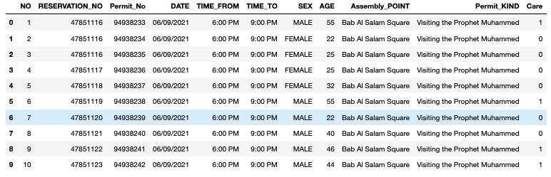
Data Exploration
Datasets contain 3545 instances.
Datasets contain 11 attribute.

Slide 4
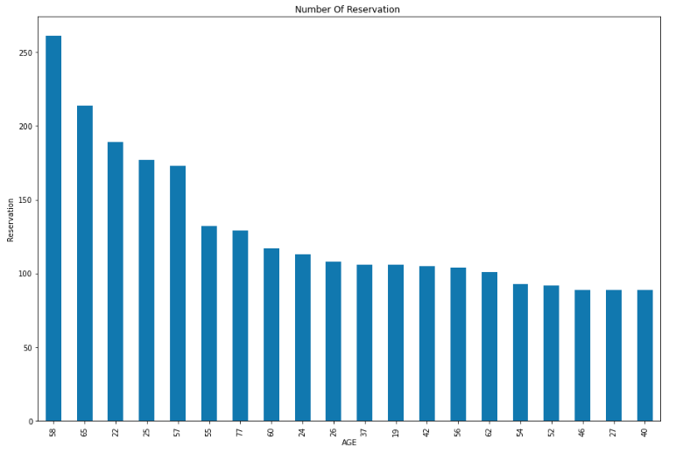
Data Exploration
The graph shows the ages and numbers of people who made reservations.

Slide 5
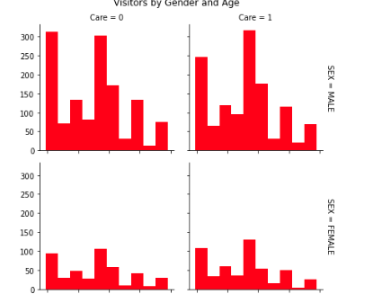
EDA
Exploratory data analysis

Slide 6
Thank You

